Slide 1
Data Governance Influence Group
Inaugural Meeting
August 14, 2017

Slide 2
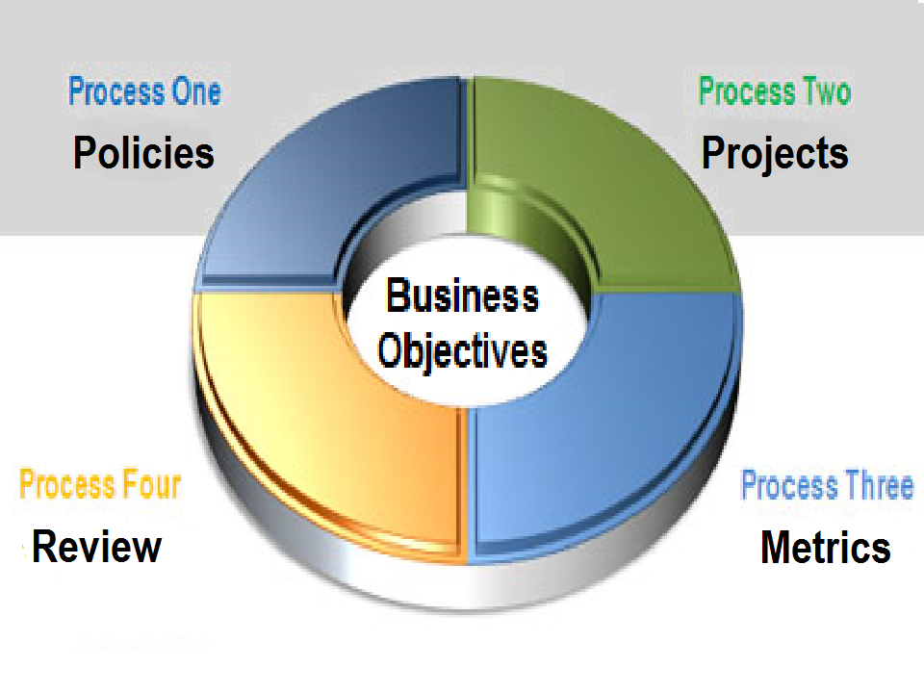
Governance Process

Slide 3
Data Governance – Why do it ?
Information is an invaluable State asset
Without appropriate & reliable data, agencies cannot deliver their services and government ceases to function
The public trust demands efficient handling, effective use, and proper safeguarding of all information assets stewarded by the State
A unified approach to information management is essential

Slide 4
Data Governance ROI
Key benefits of an effective data governance program…
“Big picture” view of Louisiana’s data landscape
Significant cost saving opportunities
Initiatives align with the State’s strategic plan objectives
Consistent data standards
Privacy, confidentiality, and security reinforcement
Focused attention on data quality & sharing

Slide 5
Data Governance Influence Group
Governance body responsible for Louisiana’s data management practices
Authority encompasses the executive branch agencies
Group consists of 7 voting members (5 agency representatives)
Focus on enterprise (multi-agency) initiatives, mission-critical data, and regulatory compliance
Responsible for development, enhancement, and maintenance of the State’s data management strategy

Slide 6
Group Member Introductions
Kenneth Burrell, Deputy Executive Director (LWC)
Beverly Hodges, Undersecretary (DNR)
Anne Villa, Undersecretary (LED)
Kim Nesmith, Data Quality & Management Director (LDOE)
Guy Sylvester, Program Manager (DCFS)
Randy Davis, Assistant Commissioner (DOA)
Robert Manuel, Chief Data Officer (DOA OTS)

Slide 7
Today’s Agenda . . .
Data Governance Foundational Documents
Overview – Five documents fundamental to the work of the Data Governance Influence Group
Objective – Introduce Group members to the 5 foundational documents in anticipation of ratification and subsequent activities
Data Governance Focal Initiatives
Overview – Preliminary list of “Top 5” data governance initiatives
Objective – Initiate discussion and consideration of pending initiatives

Slide 8
Foundational Documents
Data Governance Influence Group Charter
Enterprise Data Governance Agenda Format & Template
Enterprise Data Management Strategy Overview
Enterprise Data Management Plan
Enterprise Data Management Policies & Standards
Group Ratification Required

Slide 9
Focal Initiatives
Enterprise Data Management Strategy
Enterprise Architecture
Master Data Repositories
Data Sharing Agreements
Advisory Committees
The Group May Choose to Focus on Other Initiatives

Slide 10
Open Forum . . .
MEMBERS
Open Forum for members to address the Group
GUESTS
Guests may address the Group as time allows

Slide 11
Vision Statement
“The State of Louisiana is committed to a strategy of continuous improvement in the efficiency, effectiveness, and security of its data management practices.”

Slide 12
For Next Meeting . . .
Charter Ratification
Agenda Format Ratification
Enterprise Data Management Strategy Review & Discussion
Focal Initiatives Review & Discussion
Overarching Objective: To formalize & finalize the Group’s organization & initial priorities

Slide 13
Final Thought…
Data governance can improve the lives of Louisiana’s citizens through better management of our information resources.

